Slide 1
JSON
JAVASCRIPT OBJECT NOTATION

Slide 2
Why should I care about JSON?
Firefox
Sessionstore.js
Bookmarks
Preferences
State
Etc.
Google Chrome
Local State
Bookmarks
Web services responses (used to be XML, now JSON – JSON is fat free XML and better suited for data interchange whereas XML is a markup language.)
Facebook uses JSON for graph API requests/responses.
Twitter
Google
etc…

Slide 3
BMW Uses JSON In Their Mobile App
https://shkspr.mobi/blog/2015/11/reverse-engineering-the-bmw-i3-api/
{ "vehicleStatus": { "vin": "WAB1C23456V123456", "mileage": 1234, "updateReason": "VEHICLE_SHUTDOWN_SECURED", "updateTime": "2015-10-30T18:45:04+0100", "doorDriverFront": "CLOSED", "doorDriverRear": "CLOSED", "doorPassengerFront": "CLOSED", "doorPassengerRear": "CLOSED", "windowDriverFront": "CLOSED", "windowDriverRear": "CLOSED", "windowPassengerFront": "CLOSED", "windowPassengerRear": "CLOSED", "trunk": "CLOSED", "rearWindow": "INVALID", "convertibleRoofState": "INVALID", "hood": "CLOSED", "doorLockState": "SECURED", "parkingLight": "OFF", "positionLight": "OFF", "remainingFuel": 8.9, "remainingRangeElectric": 73, "remainingRangeElectricMls": 45, "remainingRangeFuel": 126, "remainingRangeFuelMls": 78, "maxRangeElectric": 134, "maxRangeElectricMls": 83, "fuelPercent": 99, "maxFuel": 9, "connectionStatus": "DISCONNECTED", "chargingStatus": "INVALID", "chargingLevelHv": 58, "lastChargingEndReason": "UNKNOWN", "lastChargingEndResult": "FAILED", "position": { "lat": 51.123456, "lon": -1.2345678, "heading": 211, "status": "OK" }, "internalDataTimeUTC": "2015-10-30T18:47:44" } }

Slide 4
The JSON Data Interchange Format
ECMA-404 – The JSON Data Interchange Standard (2013)
European Computer Manufacturers Association
“Lightweight data-interchange format. It is easy for humans to read and write. It is easy for machines to parse and generate.”
“It is based on a subset of the JavaScript Programming Language, Standard ECMA-262 3rd Edition – December 1999.”
rfc4627 (https://tools.ietf.org/html/rfc4627)
It’s been around for at least 10 years (2006 posting: http://www.secretgeek.net/json_3mins)
Quoted Source: www.json.org

Slide 5
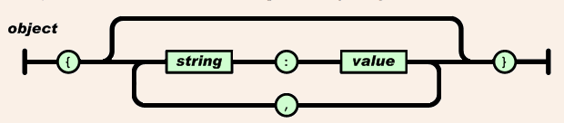
JSON Structure - object
“An object is an unordered set of name/value pairs. An object begins with { (left brace) and ends with } (right brace). Each name is followed by : (colon) and the name/value pairs are separated by , (comma).” – json.org
Ex: {“team”:”Ottawa Senators”}
or {“Ottawa”: “Ottawa Senators”, “Toronto”:“Toronto Maple Leafs”}

Slide 6
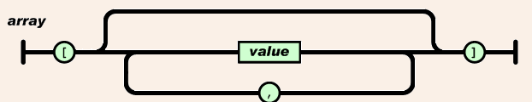
JSON Structure - array
“An array is an ordered collection of values. An array begins with [ (left bracket) and ends with ] (right bracket). Values are separated by , (comma).” – json.org
Ex: {“team”:”Ottawa Senators”,”Players”:[“Erik Karlsson”,”Craig Anderson”,”Bobby Ryan”,”Andrew Hammond”,”Mark Stone”,etc]}
Note: “Players”:[array] is a name/value pair. In this case the value is an array of values.

Slide 7
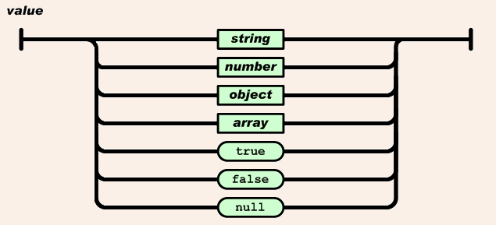
JSON Structure - value
Yes, a value can be another object.
Ex: {”Ottawa Senators”:{“city”:”Ottawa”,”Players”:[…list of players], “founded”:1990}}

Slide 8
name/value pairs
{”Ottawa Senators”:{“city”:”Ottawa”,”Players”:[…list of players], “founded”:1990}}
“Ottawa Senators”:{object}
“city”:”Ottawa”
”Players”:[array]
“founded”:1990

Slide 9
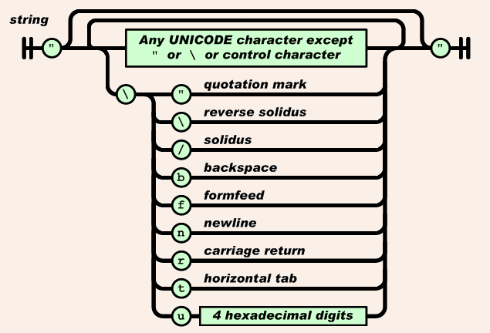
JSON Structure - string
Ex: {“letter b”:”\u0062”}

Slide 10
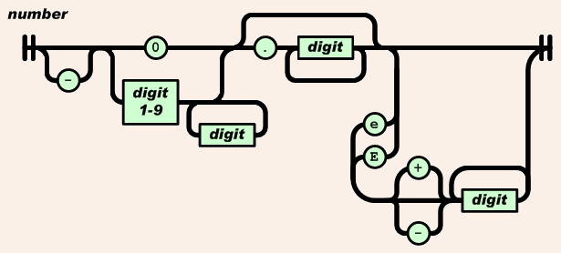
JSON Structure - number
Ex: {“speed of light”:30e8}
(which translates to 300,000,000 meters/second)

Slide 11
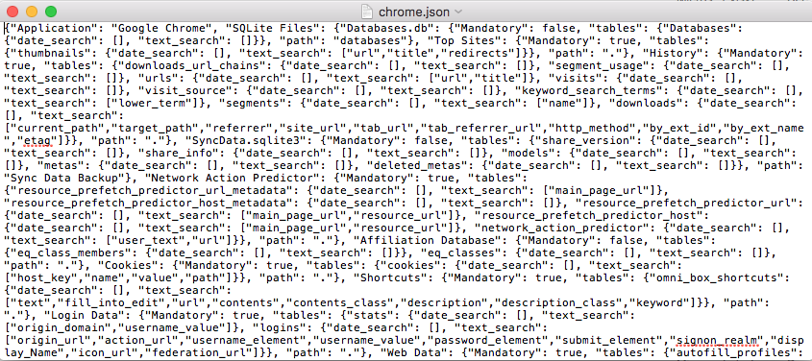
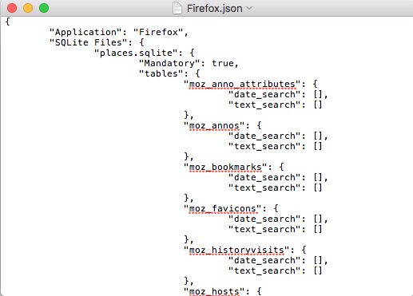
So what does it look like forensically?
“Whitespace can be inserted between any pair of tokens.” – json.org

Slide 12
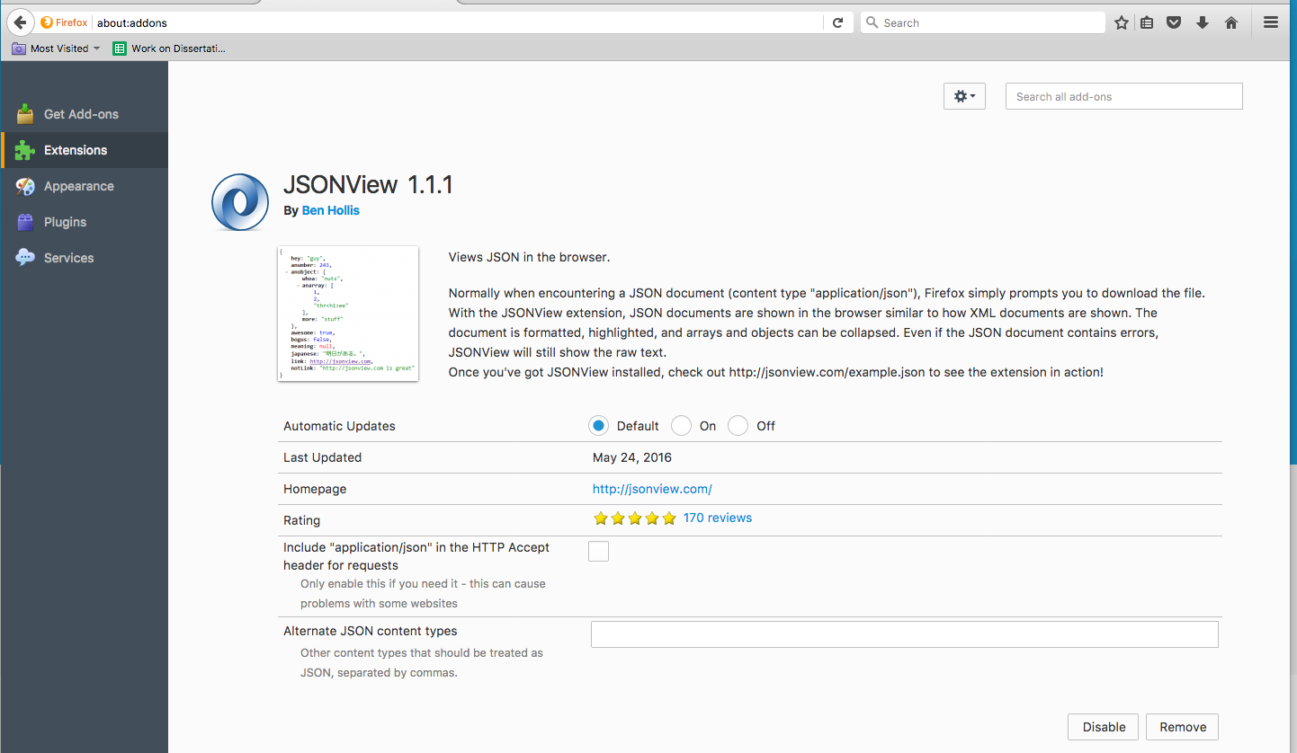
Firefox JSONView add-on

Slide 13
Let’s now look at
example1.json
example2.json
example3.json
example4.json
example5.json
example6.json

Slide 14
Notepad++ Plugin

Slide 15
Carving Partial JSON
Paritial firefox recovery.js/sessionstore.js file
We carve out objects “i.e. between the {}” to a new file we will call carved-recovery-needs-fixing.json.
When we open it, it doesn’t decode properly.

Slide 16
Fixing it…
We see two objects in there.
Let’s try adding a { at the beginning and a } at the end of the file.
Does that work?

Slide 17
Still not working… Why?
Remember that objects are name/value pairs.
We don’t have a name/value pair in that outer object. We have two objects in it.
Lets make that an array by encapsulating it between []. That should work.

Slide 18
Still won’t work. What else?
Well we still don’t have a name/value pair. We can fix that by adding
“urls”:
In front of the array and give that a try.

Slide 19
Eureka! It works!
Now we have an outer object. It’s name is “urls”. It’s value is the array.
The array contains two objects that are already properly formed.
Knowing how JSON is structured allows you to carve partial JSON data from unallocated and fix it so that it is a properly formed JSON file that will display well in JSONView add-on in Firefox.
Did something similar to this when assisting an investigator for a homicide investigation. The only difference was we carved out a proper element with other elements inside from the very first carve so didn’t have to do any fixing at all.

Slide 20
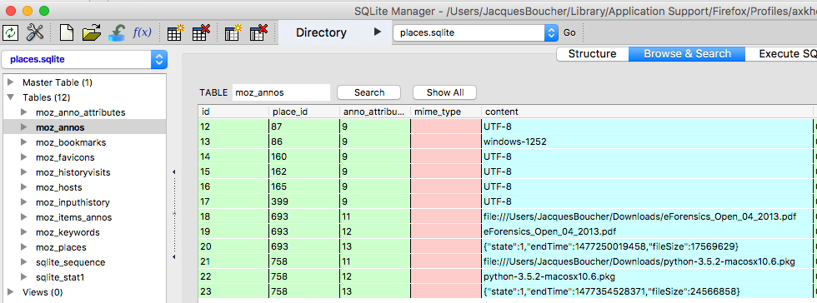
JSON in SQLite
See record #20 & #23, content field

Slide 21
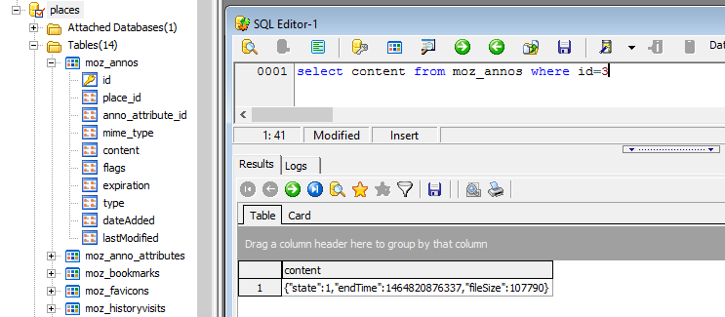
JSON in SQLite

Slide 22
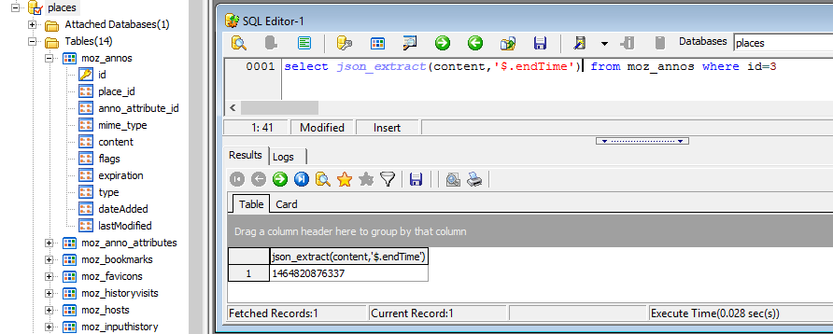
SharpPlus SQLite Developer
http://www.sqlitedeveloper.com/download

Slide 23
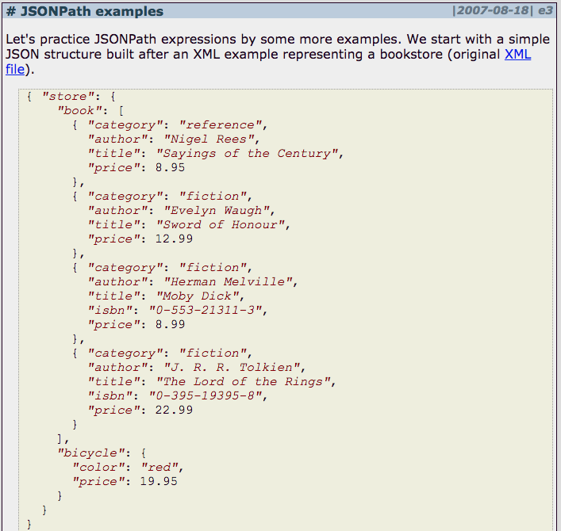
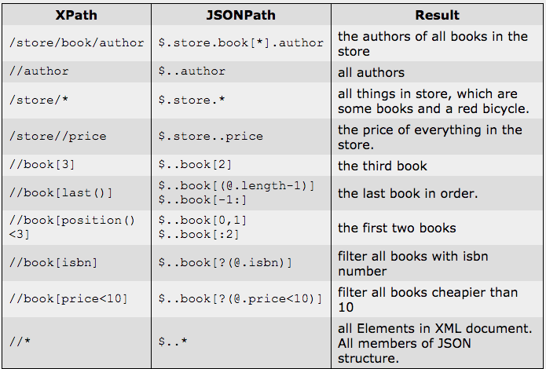
JSONPATH (XPATH for JSON)
http://goessner.net/articles/JsonPath/

Slide 24
JSON vs BSON
{'a':[1,2,3,4],'car':'phone'}
b'8\x00\x00\x00\x04a\x00!\x00\x00\x00\x100\x00\x01\x00\x00\x00\x101\x00\x02\x00\x00\x00\x102\x00\x03\x00\x00\x00\x103\x00\x04\x00\x00\x00\x00\x02car\x00\x06\x00\x00\x00phone\x00\x00'

Slide 25
Using Python 3.5.2
For SQLite:
sqlite_example.py
downloads.py
download_decode.py
For JSON
See download_decode.py as it uses JSON library as well.
For BSON
bsonExample.py
Do not call it bson.py as now you have a file bearing the same name as the library, bson. It will give you an error.

Slide 26

Questions?
Jacques Boucher
jjrboucher@gmail.com

